Slide 1
1 / 10
S&P 500 Market-Neutral Multi-Factor Strategy
S&P 500 · 2011–2024 · Monthly Rebalancing · Value / Size / Momentum
THE PROBLEM
FINAL RESULTS — Full-Constraint Portfolio
Can a classical 3-factor signal (Value, Size, Momentum) still produce usable alpha in the S&P 500 once we impose PIT discipline, full market-neutral portfolio construction, and realistic trading costs?
Net Ann. Return
Ann. Volatility
+7.53%
13.99%
Gross +9.52%
vs 18.22% baseline
Full pipeline:
PIT data → Pure factor returns → FRP weighting → PCA risk model → convex optimizer→ FF5 Attribution
Hard constraints:
beta-neutral, dollar-neutral, leverage ≤ 2.5×, sector-neutral
Survivorship-bias-free, look-ahead prevention (PIT)
Net Sharpe Ratio
Max Drawdown
0.50
−23.2%
Gross 0.63
vs −25.5% baseline
Period 2011-12 → 2024-12 (157 months) | Monthly rebalance | Costs included in “Net”| Cost model: 5 bp commission + 5 bp impact (one-way) + 50 bp annualized borrow on short exposure

Slide 2
2 / 10
End-to-End Architecture
Four-phase pipeline: Data &PIT → signal generation → portfolio construction → performance attribution
01
02
03
04
PHASE 1
PHASE 2
PHASE 3
PHASE 4
Data &
PIT Pipeline
Signals &
Factor Risk Parity
Risk Model &
Optimization
Backtest &
Attribution
871 ever-in-SP500 names
CRSP/CCM + Compustat
PIT delay and assertCRSP price + COMPUSTAT
No survivorship: keep pre-entry & post-exit history
Value / Size / Momentum
Cross-sec regression
Pure factor returns f̃
FRP: PCA-orthogonalize dynamic weights
Core ~55 names → EWMA daily cov → corr-PCA
Regress all stocks on PCs
Convex optimizer
Dollar-neutral / Hard β / leverage / sector-neutral
NAV backtest
10bp + 50bp cost model
Attribution diagnostics
A/B: Full-Constraint vs Preliminary
›
›
›
OUTPUT
OUTPUT
OUTPUT
OUTPUT
Monthly returns + PIT signals
Expected returns μ(i,t)
Portfolio weights w*(t)
Net Sharpe 0.50
FF5 α = +7.55%

Slide 3
3 / 10
Data Pipeline & Anti Look-Ahead (PIT Discipline)
PHASE 1 OUTPUT ARTEFACTS
THREE-LAYER ANTI LOOK-AHEAD CONTROL
Price Panel
1
PIT Availability Rule
sp500_price_panel_with_delist.csv
Fundamentals enter the signal panel only after they are point-in-time available: pit_date = max(rdq + 1, datadate + 45d),
with an observed lag of at least 45 days and a 45-day median.
871 ever-in-SP500 names · 2,934,733 daily rows
2008-01-02 to 2024-12-31 · ret_adj + dynamic in_sp500 flag
PIT Fundamentals
sp500_fundq_pit_rebuilt_nodvmt.csv
2
Backward As-Of Merge
53,985 firm-quarter rows · 866 gvkeys
pit_date uses rdq and ≥45d from datadate
A backward merge_asof enforces pit_date ≤ month-end at merge time, so future filings are excluded by construction rather than by assumption.
Monthly Returns
sp500_monthly_returns.csv
140,070 rows · 871 permnos · 2008-01 to 2024-12
Compounded from daily delisting-adjusted returns
3
Assertion & QC Layer
The pipeline uses assertion-based quality checks on timestamp ordering, merge validity, and row uniqueness, and fails loudly if any leakage or duplicate-row anomaly is detected.
Monthly Signals
sp500_monthly_signals_rebuilt_nodvmt.csv
115,962 rows · 822 permnos
Value / Size / Momentum · intra-sector robust Z-scores
No survivorship bias:
full history retained for all ever-in-SP500 names, including pre-entry and post-exit periods.

Slide 4
4 / 10
Signal Engineering → FRP → Expected Returns μ(i,t)
01
02
03
04
Task 2.1
Task 2.2
Task 2.3
Task 2.4
Factor Exposures
Pure Factor Returns
Factor Risk Parity
Expected Returns
Value = 0.67 · EY_{z} + 0.33 · PB_{z}
Size = − mktcap_{z}
Mom = rawMom_{z}
All Z-scores computed within GICS sectors — eliminates natural industry factor bias
Each month, run a cross-sectional OLS of stock returns on Factor exposures
The fitted coefficients are the pure factor returns
This removes cross-factor collinearity and isolates each factor’s incremental payoff
Estimate a rolling EWMA covariance of pure factor returns
PCA decorrelates the three pure factors
Solve for w_{FRP}
Each factor contributes roughly one-third of composite risk
μ(i,t) = σ(i,t) × Z_{FRP}
Z_FRP is the FRP-weighted composite signal
σ(i,t) is trailing 12-month stock volatility
Final output is winsorized and passed to the optimizer
›
›
›
Robust intra-sector exposures
180 months · avg. 477 stocks/month
157 monthly weight vectors
Stock-month μ(i,t) estimates

Slide 5
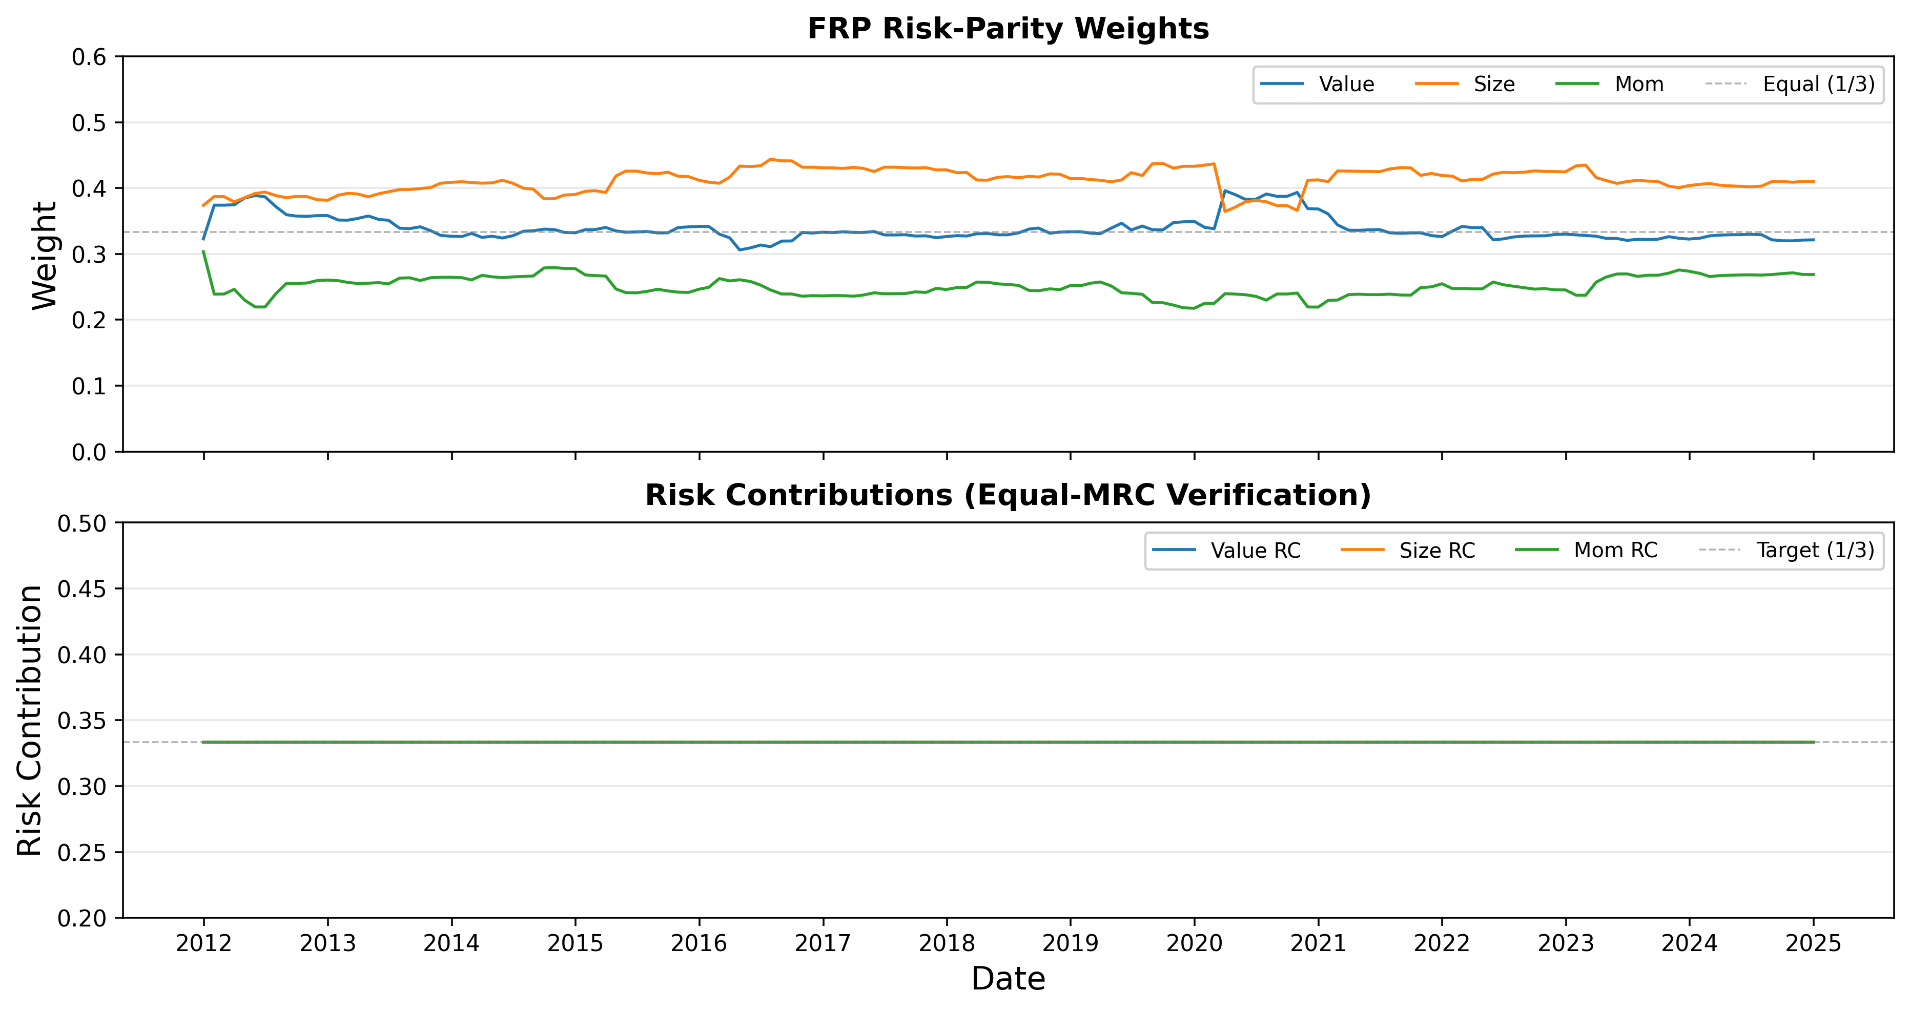
5 / 10
Figure 1 — FRP Dynamic Weights & Risk Contributions
FIGURE 1 - Monthly FRP weights & Risk contributions
WEIGHT SUMMARY (157 months)
Factor
Mean
Std
Min
Max
TIME-SERIES CHART (two panels):
Top panel: Monthly FRP weights — w_value (blue), w_size (green), w_mom (orange)
X-axis: 2011-12 → 2024-12 · Y-axis: weight (0 to 0.5)
Bottom panel: Risk contributions rc_value / rc_size / rc_mom
Should each track ≈ 33.3% (equal-MRC confirmation)
Source file: sp500_frp_weights.csv.gz
Columns: month, w_value, w_size, w_mom, rc_value, rc_size, rc_mom
Value
33.8%
1.8%
30.6%
39.6%
Size
41.1%
1.8%
36.4%
44.4%
Momentum
25.0%
1.5%
21.8%
30.3%
INSIGHT
Size receives highest weight because its pure factor return variance is largest, FRP down-weights automatically
Risk contributions are each exactly 33.3% every month constraint is satisfied with near-perfect precision
2020 — Size pure factor return variance surges;
FRP reduces Size weight and reallocates to Value to maintain equal risk contribution
Month-over-month weight shifts are small (mean |Δw| < 0.004), the signal is stable, not noise-driven

Slide 6
6 / 10
Table 1 & 2 — Pure Factor Return Statistics & FF5 Validation
TABLE 1 — PURE FACTOR RETURN SUMMARY (180 months, Jan 2010 → Dec 2024)
Factor
Monthly Mean
Monthly Std
FM t-stat
p-value
Sig.
Avg stocks / cross-section: 477 Cross-sect. R²: mean 0.039
Intercept (α)
+0.84%
4.88%
2.31
0.022
**
Value
+0.15%
0.85%
2.40
0.017
**
Size
−0.51%
0.84%
−8.17
0.000
***
Momentum
−0.06%
1.23%
−0.66
0.513
—
Value is statistically significant and Size is the dominant priced effect, while Momentum is not significant over this sample period.
TABLE 2 — VALIDATION: PURE FACTOR RETURNS vs FAMA-FRENCH 5 FACTORS
Comparison
Correlation
p-value
Sig.
Value vs HML (FF)
−0.062
0.406
—
Size vs SMB (FF)
+0.64
0.000
***
Mom vs MktRF (FF)
−0.29
0.000
***
Value vs SMB (cross)
−0.15
0.043
**
Size vs HML (cross)
+0.44
0.000
***
Validation shows that Size maps cleanly to SMB, while Value is not a direct HML under our intra-sector construction.

Slide 7
7 / 10
Phase 3 — Rolling PCA Risk Model & Convex Optimizer
RISK MODEL (Task 3.1) — Rolling PCA factor model
OPTIMIZER DESIGN (Task 3.2)
Stratified Core Selection
OBJECTIVE
1
~55 core names from 11 GICS sectors, reselected monthly
Avg. universe coverage: 633 stocks/month
Within each sector, stocks are sorted by market cap and sampled across equal-count strata
$$\min_{w}{ } −μ^{⊤}w+\frac{γ}{2}w^{⊤}Σw+c|w−w_{\text{prev}}|_{1}$$
γ = 1.0 risk aversion · c = 0.005 turnover penalty
CONSTRAINT LAYERS
EWMA Covariance + Correlation PCA
Layer 1
Baseline Case
Dollar neutral: ∑wᵢ = 0
Gross leverage: ‖w‖₁ ≤ 2.5
Single-name cap: ∣𝑤𝑖∣≤2%
2
EWMA cov, half-life = 480d, using up to ~10 years of daily data
PCA is run on the correlation matrix, with post-PCA shrink α = 5%
~30 PCs used; mean cum. variance explained = 88.0%
Layer 2
Additional enhancements
Beta neutrality: ∣𝛽𝑚𝑘𝑡⊤𝑤∣≤0.05∣
Vol target: ann. vol ≤10%
Sector band: ±2% net sector exposure
SMB neutrality: soft penalty in objective
Universe Regression + Σ Reconstruction
3
Regress all names on PC returns to estimate β loadings and λₑ
Store monthly β, Ω_f, λₑ for optimization
Portfolio risk is computed as βΩ_fβ′ + Λ
Final QC
157/157 months solved
Strict constraints used in all months
Max |β·w| = 0.0501
Avg positions: 68L + 70S

Slide 8
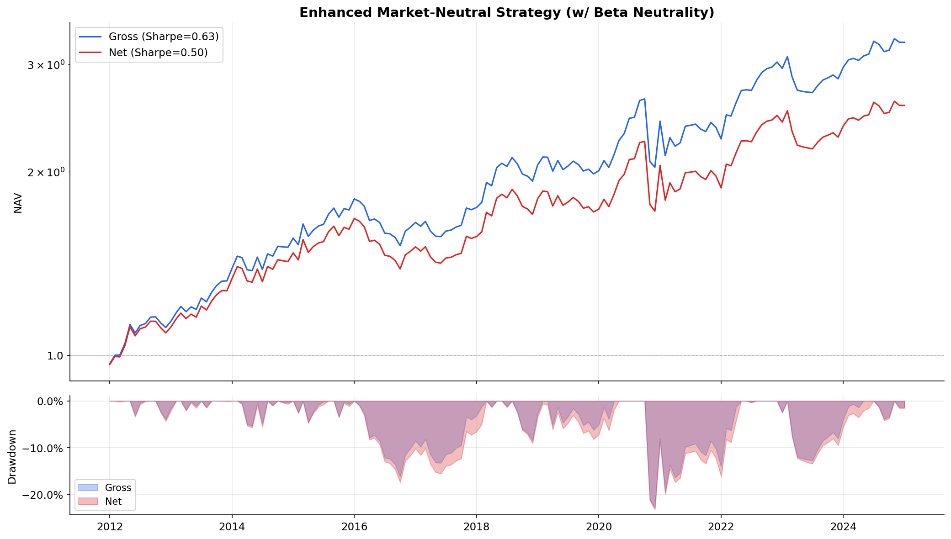
8 / 10
Figure 2 & Table 3 — Backtest Results & FF5 Attribution
FIGURE 2 —NAV & DRAWDOWN
Table 3 - FF5 ATTRIBUTION
Factor
Prelim coef
p
Full. coef
p
Alpha (monthly)
+0.00843
0.076 *
+0.00629
0.097 *
Mkt-RF
+0.154
0.184
+0.127
0.183
SMB
−0.613
0.007 ***
−0.405
0.030 **
RMW
−0.490
0.019 **
−0.333
0.027 **
HML
+0.270
0.226
+0.195
0.294
Alpha remains positive but only borderline significant (+7.55% ann., p = 0.097); with 157 months and R² = 5.9%, FF5 explains only a small share of strategy returns.
Residual exposure is concentrated in SMB and RMW: the portfolio loads negatively on both, consistent with a large-cap tilt inside the S&P 500 and a Value–Quality trade-off in our 3-factor signal set.
Interpretation: more like a factor-model limitation than a pipeline failure—our signals are defined differently from FF5 and do not directly span profitability/investment dimensions.
The full-constraint portfolio compounds steadily through the sample and remains strongly profitable after costs, with net annual return of 7.53%, net Sharpe of 0.50, and net max drawdown of 23.18%

Slide 9
9 / 10
Table 4 — A / B COMPARISON
Metric
Baseline
Full-Constraint
Δ
This is not a return-maximization upgrade
It is a risk-control upgrade
Gross Ann. Return
+11.81%
+9.52%
−229 bps
Net Ann. Return
+9.83%
+7.53%
−230 bps
Vol falls because constraints get tighter:
beta neutrality, w_max = 2%, and broader diversification reduce concentration risk.
Return and alpha fall for the same reason:
a tighter feasible set leaves less room to express the strongest signals.
SMB improves but does not vanish:
the final optimizer controls market beta, not the full FF5 factor vector, and uses only a soft SMB penalty.
Turnover improves only modestly:
both versions rebalance monthly on the same 157-month schedule, so signal refresh still drives most trading.
Ann. Volatility
18.22%
13.99%
−423 bps
Gross Sharpe
0.637
0.632
-0.005
Net Sharpe
0.538
0.500
−0.038
Gross Max DD
−24.38%
−22.76%
+162 bps
Net Max DD
−25.52%
−23.18%
+234 bps
Avg Monthly TO
54%
51%
−3 ppts
Avg Positions
~25L + 26S
~68L + 70S
+87
Mkt Beta (FF5)
+0.154
+0.127
−0.027
SMB Beta (FF5)
−0.613
−0.405
+0.208
FF5 α gross ann.
+10.11%
+7.55%
-256 bps
FF5 α p-value
0.076 *
0.097 *
—
Green = Enhanced meaningfully better · Cost: 10bp one-way + 50bp borrow

Slide 10
10 / 10
Conclusion
What we built · What we found · What it implies
What We Built
What We Found
What It Implies
Reproducible research stack: PIT data panel → FRP expected returns → rolling PCA risk model → convex optimizer → FF5 attribution.
Final portfolio construction: dollar neutrality, sector bands, leverage control, beta neutrality, tighter name caps, and a soft SMB penalty.
Auditable implementation: delisting-adjusted prices, PIT delay max(rdq+1, datadate+45d), merge/uniqueness checks, and 157 monthly model runs.
Full-Constraint final portfolio: Net +7.53% ann., 13.99% vol, 0.50 Sharpe, -23.18% max drawdown, with 157/157 months solved under strict constraints
Compared with baseline: lower vol and drawdown, cleaner market/SMB exposure, but lower return and lower FF5 alpha; the book also becomes much broader
FF5 attribution: alpha remains positive but borderline, while residual loadings are concentrated in SMB and RMW rather than market beta alone.
This is a risk-control upgrade, not a return-maximization win: tighter constraints cut concentration risk and drawdowns, but also compress signal expression and alpha capture.
The main limitation is signal space, not pipeline integrity: a 3-factor, intra-sector, MAD-winsorized design does not fully line up with FF5 and does not directly span profitability/investment dimensions.
Natural next step: add Quality/Profitability (and potentially Investment) signals, or impose explicit neutrality on residual FF-style tilts such as SMB/RMW.

Slide 11
APX
Appendix — Data Files & Code Notebooks
A. DATA (CSV / CSV.GZ)
B. CODE (Jupyter Notebooks)
sp500_price_panel_with_delist.csv.gz — Price panel · 871 stocks · 2.9M rows · 2008–2024 · delist-adjusted
HFS_Project_Data_Fetcher_0304.html
sp500_monthly_returns.csv.gz — Monthly returns · 140,070 rows · ret_monthly, in_sp500_eom
Phase 1 — Data ingestion, PIT rebuild, delistings, price panel
sp500_ccm_lnkhist_all_nodvmt.csv.gz — CRSP-Compustat link history · 1,067 firm-links
HFS_Phase2_Momentum.html
Phase 2 — Momentum signal engineering
sp500_fundq_pit_rebuilt_nodvmt.csv.gz — PIT quarterly fundamentals · 53,985 rows
HFS_Phase2_Task2_2_CrossSectionalRegression.html
sp500_monthly_signals_rebuilt_nodvmt.csv.gz — Monthly signals (Value, Size) · 115,962 rows · sector-Z-scored
Phase 2 — Fama-MacBeth cross-sectional regression
sp500_monthly_signals_3factor.csv.gz — Monthly signals (Value, Size, Momentum) · 115,962 rows
HFS_Phase2_Task2_3_FRP_and_ExpectedReturns.html
Phase 2 — FRP weights + expected return vector μ(i,t)
sp500_pure_factor_returns.csv.gz — Pure factor returns · 180 months · f_value, f_size, f_mom
HFS_Phase3_Task3_1_PCA_RiskModel.html
sp500_frp_weights.csv.gz — FRP dynamic weights · 157 months · w_value, w_size, w_mom
Phase 3 — PCA risk model (EWMA cov + Ledoit-Wolf)
sp500_expected_returns.csv.gz — Expected returns μ(i,t) · 99,363 stock-months
HFS_Phase3_Task3_2_Optimizer.html
Phase 3 — Preliminary optimizer + backtest (Task 3.2)
sp500_risk_models.pkl — PCA risk model objects B, Ω, Δ per month (157 pickled dicts)
HFS_Phase3_Task3_3_Enhanced_Optimizer_Phase4.html
sp500_backtest_results.csv.gz — Preliminary backtest results · 157 months · all metrics
Phase 3+4 — Enhanced optimizer, QC + FF5 attribution
sp500_backtest_results_enhanced.csv.gz — Enhanced backtest results · 157 months · all metrics
HFS_Phase4_Task3_2_Backtest_Attribution.html
Phase 4 — Full FF5 attribution on Preliminary backtest
sp500_portfolio_weights_enhanced.csv.gz — Enhanced portfolio weights · 49,469 stock-month records
FF_Research_Data_5_Factors_2x3_daily.CSV — Fama-French 5-factor daily data (WRDS)

